Slide 1
Estimation of Training Data Influence
Huangzhao Zhang
zhang_hz@pku.edu.cn

Slide 2
Overview
What is training data influence?
TracIn – NeurIPS 2020
CosIn – ICML 2021
GAS & FIT – Extension of CosIn

Slide 3
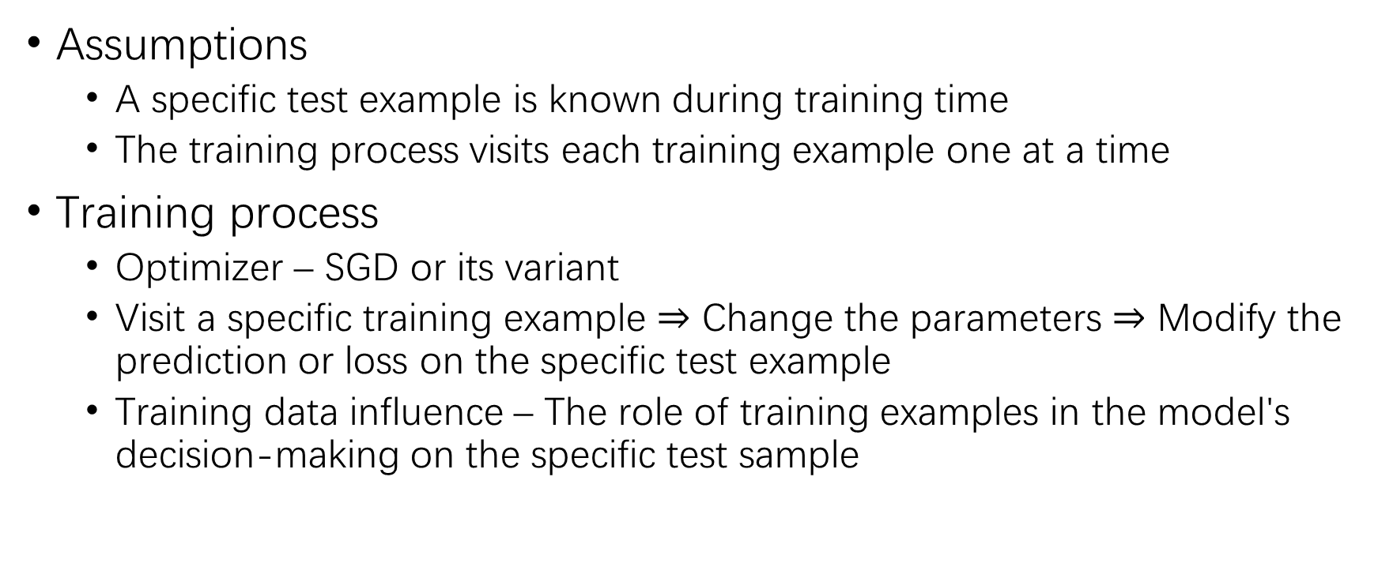
Training Data Influence
Assumptions
A specific test example is known during training time
The training process visits each training example one at a time
Training process
Optimizer – SGD or its variant
Visit a specific training example $⇒$ Change the parameters $⇒$ Modify the prediction or loss on the specific test example
Training data influence – The role of training examples in the model's decision-making on the specific test sample

Slide 4
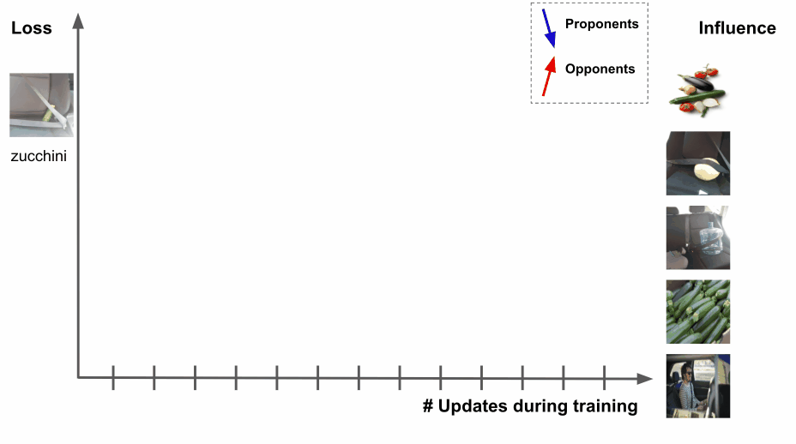
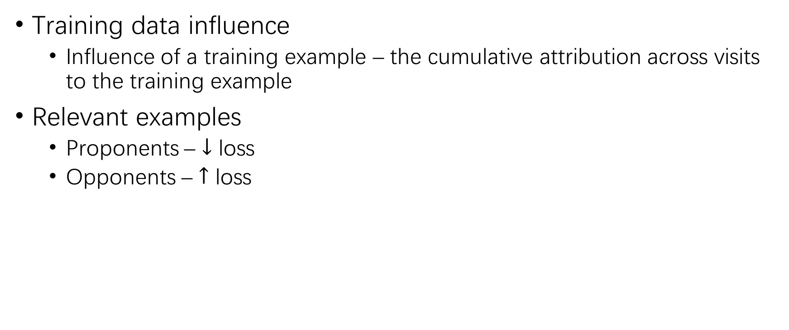
Training Data Influence (2)
Training data influence
Influence of a training example – the cumulative attribution across visits to the training example
Relevant examples
Proponents – $↓$ loss
Opponents – $↑$ loss

Slide 5
Training Data Influence (3)
Challenges
On-the-fly – The specific test example is unknown at training time
Most training algorithms visit batches rather than individual examples
Possible solution – TracIn
Training process sketch – Checkpoints
Pointwise loss gradient

Slide 6
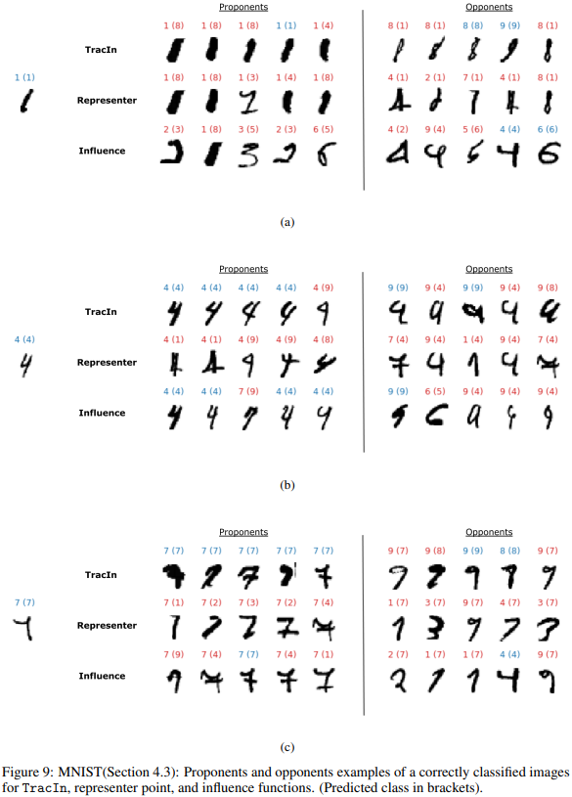
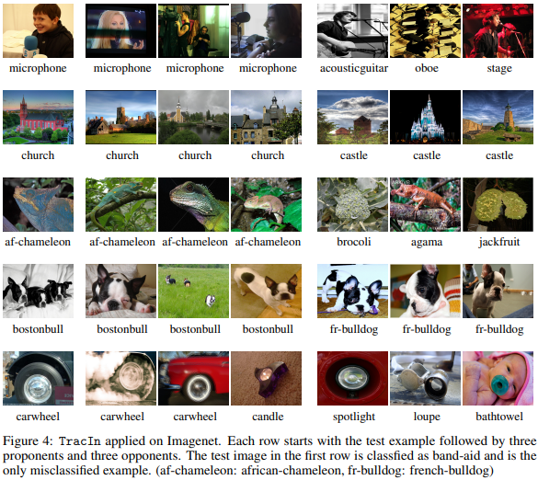
Training Data Influence (4)
Applications
Model explanation
Poison detection
…

Slide 7
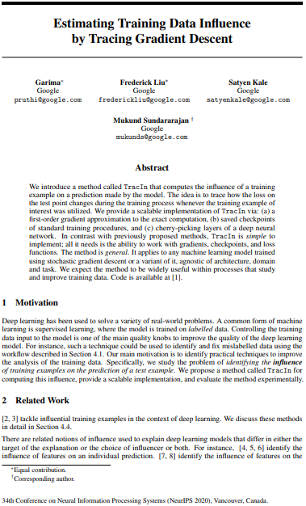
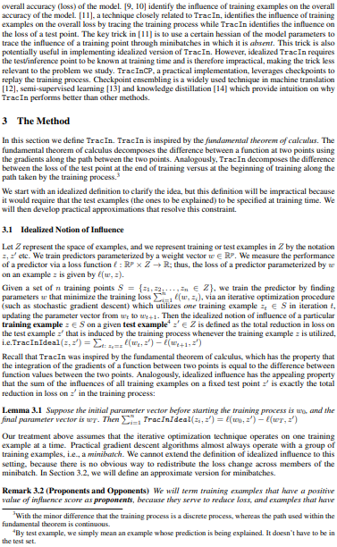

Slide 8
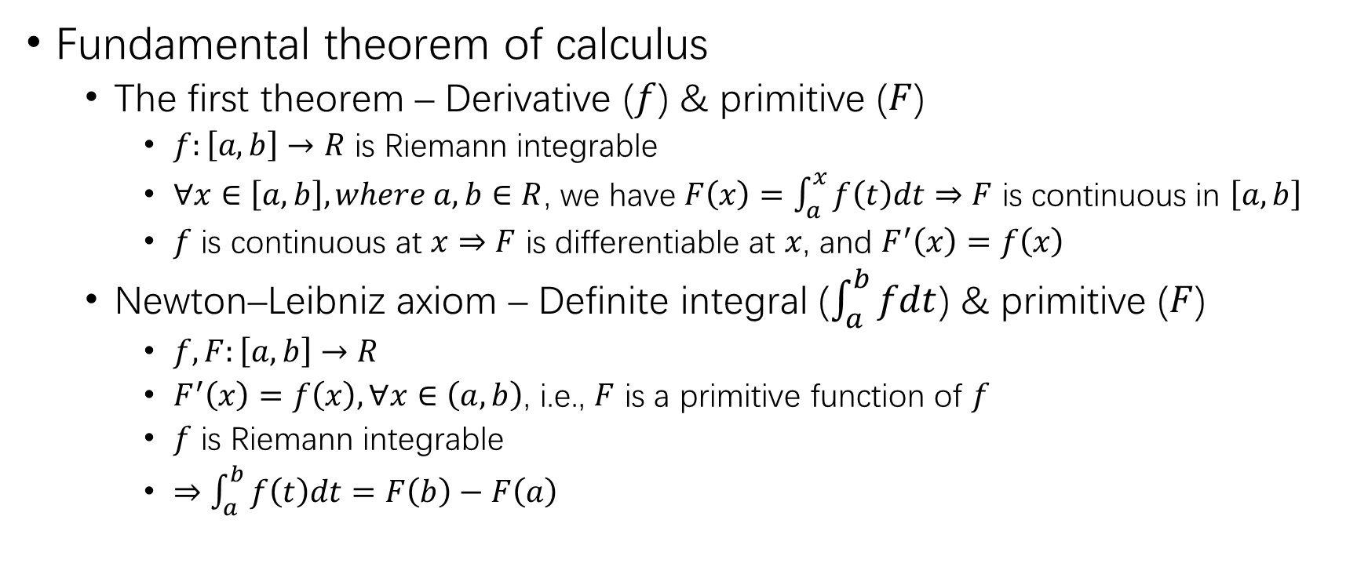
Inspiration
Fundamental theorem of calculus
The first theorem – Derivative ($f$) & primitive ($F$)
$f:\left[a,b\right]→R$ is Riemann integrable
$∀x∈\left[a,b\right], where a,b∈R$, we have $F\left(x\right)=\int_{a}^{x}{f\left(t\right)dt}$ $⇒$ $F$ is continuous in $\left[a,b\right]$
$f$ is continuous at $x$ $⇒$ $F$ is differentiable at $x$, and $F^{′}\left(x\right)=f\left(x\right)$
Newton–Leibniz axiom – Definite integral ($\int_{a}^{b}{fdt}$) & primitive ($F$)
$f,F:\left[a,b\right]→R$
$F^{′}\left(x\right)=f\left(x\right),∀x∈\left(a,b\right)$, i.e., $F$ is a primitive function of $f$
$f$ is Riemann integrable
$⇒$ $\int_{a}^{b}{f\left(t\right)dt}=F\left(b\right)−F\left(a\right)$

Slide 9
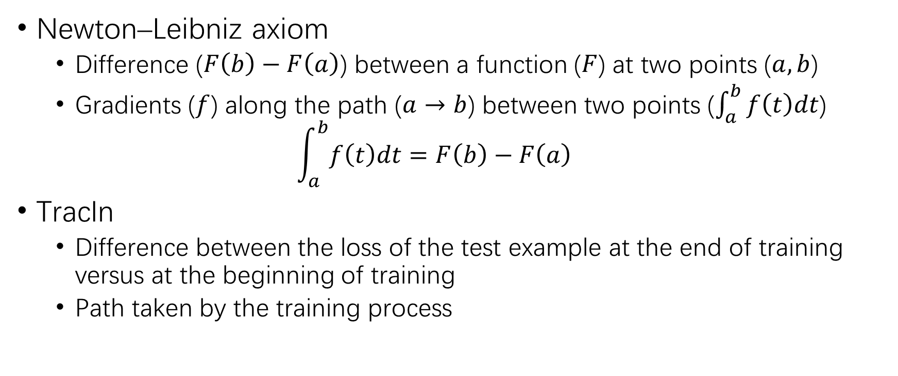
Inspiration (2)
Newton–Leibniz axiom
Difference ($F\left(b\right)−F\left(a\right)$) between a function ($F$) at two points ($a,b$)
Gradients ($f$) along the path ($a→b$) between two points ($\int_{a}^{b}{f\left(t\right)dt}$)
$$\int_{a}^{b}{f\left(t\right)dt}=F\left(b\right)−F\left(a\right)$$
TracIn
Difference between the loss of the test example at the end of training versus at the beginning of training
Path taken by the training process

Slide 10
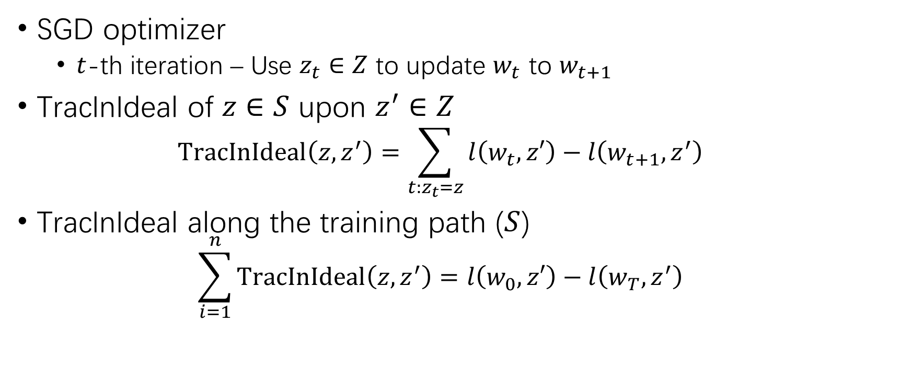
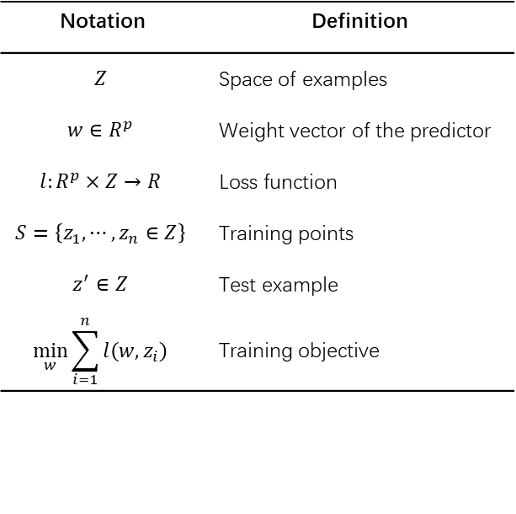
Idealized Notion of Influence
Notation | Definition
$$Z$$ | Space of examples
$$w∈R^{p}$$ | Weight vector of the predictor
$$l:R^{p}×Z→R$$ | Loss function
$$S=\left\{z_{1},⋯,z_{n}∈Z\right\}$$ | Training points
$$z^{′}∈Z$$ | Test example
$$\min_{w}{\sum_{i=1}^{n}{l\left(w,z_{i}\right)}}$$ | Training objective
SGD optimizer
$t$-th iteration – Use $z_{t}∈Z$ to update $w_{t}$ to $w_{t+1}$
TracInIdeal of $z∈S$ upon $z^{′}∈Z$
$$TracInIdeal\left(z,z^{′}\right)=\sum_{t:z_{t}=z}{l\left(w_{t},z′\right)−l\left(w_{t+1},z^{′}\right)}$$
TracInIdeal along the training path ($S$)
$$\sum_{i=1}^{n}{TracInIdeal\left(z,z^{′}\right)}=l\left(w_{0},z′\right)−l\left(w_{T},z^{′}\right)$$

Slide 11
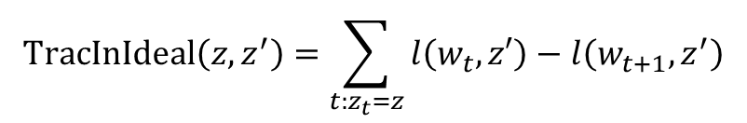
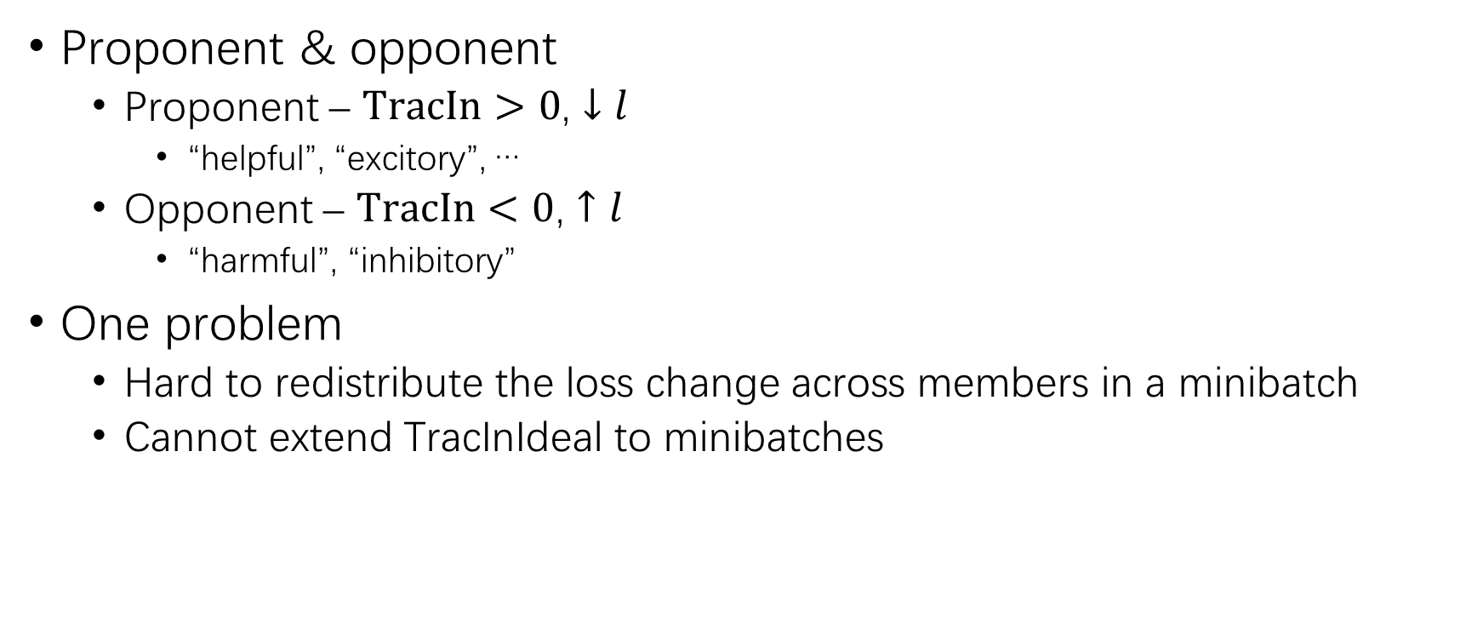
Idealized Notion of Influence (2)
Proponent & opponent
Proponent – $TracIn>0$, $↓l$
“helpful”, “excitory”, …
Opponent – $TracIn<0$, $↑l$
“harmful”, “inhibitory”
One problem
Hard to redistribute the loss change across members in a minibatch
Cannot extend TracInIdeal to minibatches
$$TracInIdeal\left(z,z^{′}\right)=\sum_{t:z_{t}=z}{l\left(w_{t},z′\right)−l\left(w_{t+1},z^{′}\right)}$$

Slide 12
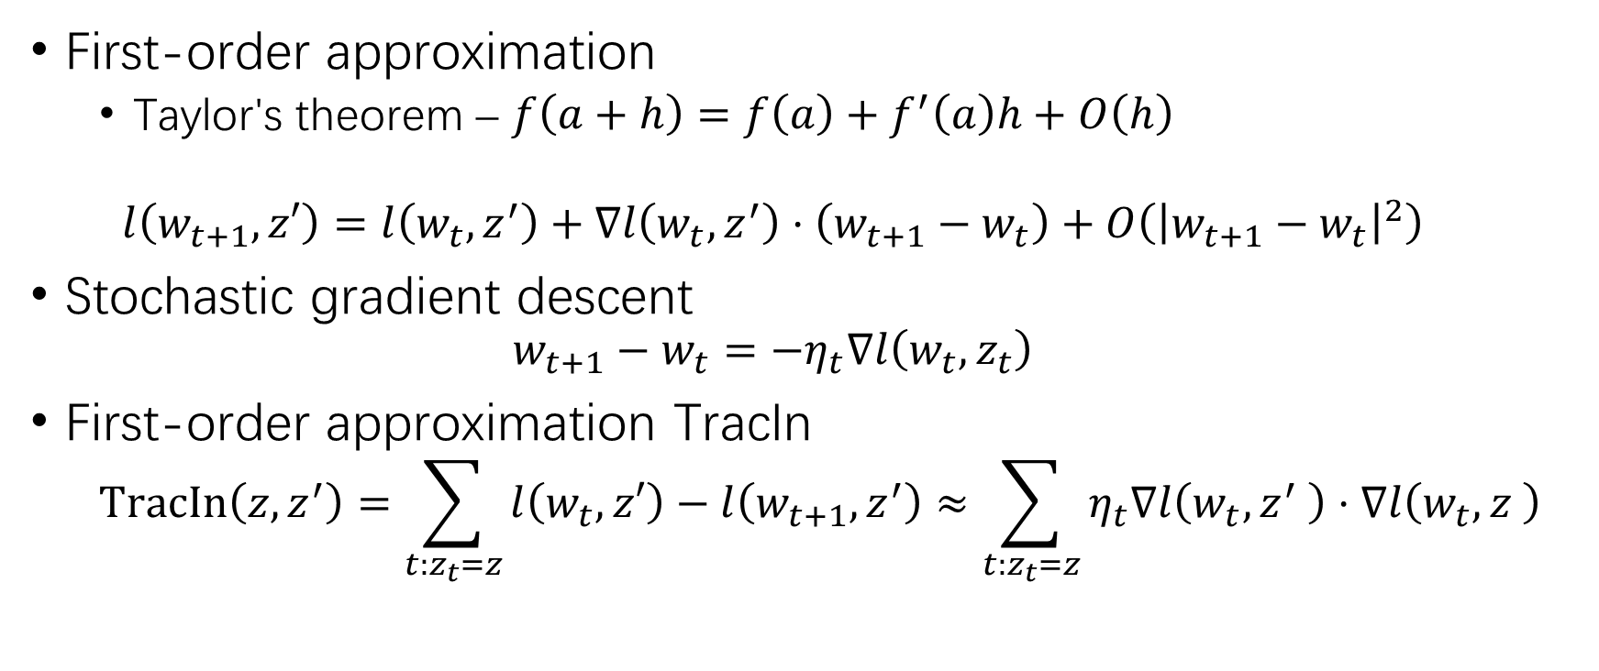
Extend TracIn to Minibatches
First-order approximation
Taylor's theorem – $f\left(a+h\right)=f\left(a\right)+f^{′}\left(a\right)h+O\left(h\right)$
$$l\left(w_{t+1},z′\right)=l\left(w_{t},z^{′}\right)+∇l\left(w_{t},z^{′}\right)⋅\left(w_{t+1}−w_{t}\right)+O\left({\left|w_{t+1}−w_{t}\right|}^{2}\right)$$
Stochastic gradient descent
$$w_{t+1}−w_{t}=−η_{t}∇l\left(w_{t},z_{t}\right)$$
First-order approximation TracIn
$$TracIn\left(z,z^{′}\right)=\sum_{t:z_{t}=z}{l\left(w_{t},z′\right)−l\left(w_{t+1},z^{′}\right)}≈\sum_{t:z_{t}=z}{η_{t}∇l\left(w_{t},z^{′} \right)⋅∇l\left(w_{t},z \right)}$$

Slide 13
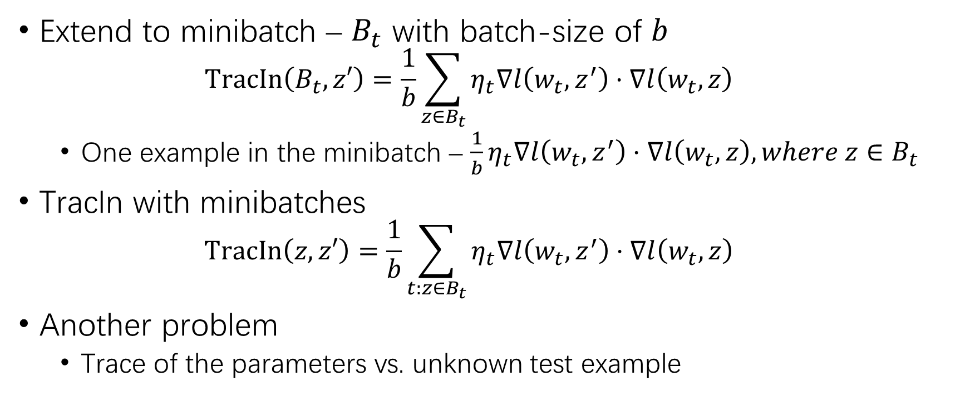
Extend TracIn to Minibatches (2)
Extend to minibatch – $B_{t}$ with batch-size of $b$
$$TracIn\left(B_{t},z′\right)=\frac{1}{b}\sum_{z∈B_{t}}{η_{t}∇l\left(w_{t},z^{′}\right)⋅∇l\left(w_{t},z\right)}$$
One example in the minibatch – $\frac{1}{b}η_{t}∇l\left(w_{t},z^{′}\right)⋅∇l\left(w_{t},z\right),where z∈B_{t}$
TracIn with minibatches
$$TracIn\left(z,z′\right)=\frac{1}{b}\sum_{t:z∈B_{t}}{η_{t}∇l\left(w_{t},z^{′}\right)⋅∇l\left(w_{t},z\right)}$$
Another problem
Trace of the parameters vs. unknown test example

Slide 14
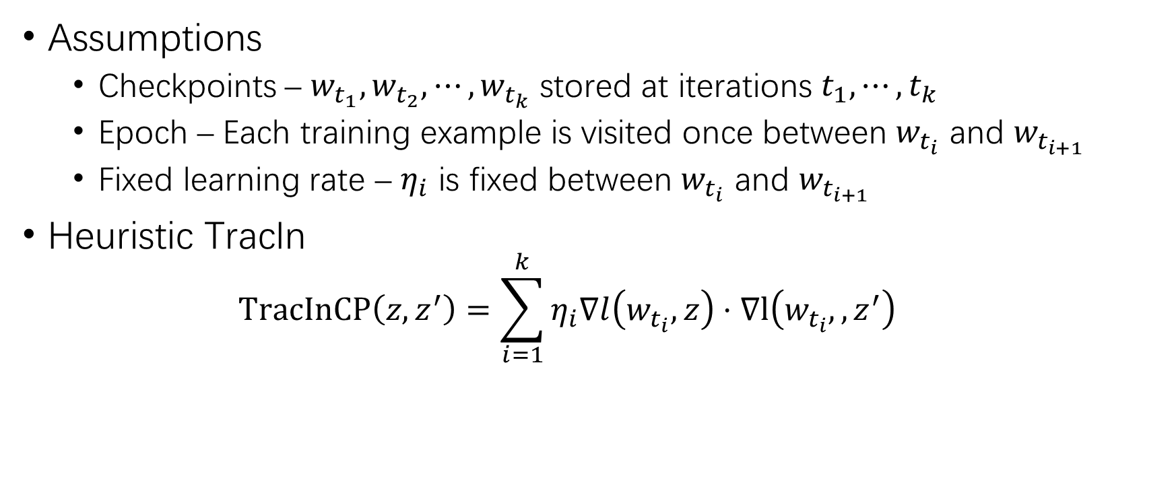
Practical Heuristic TracIn via Checkpoints
Assumptions
Checkpoints – $w_{t_{1}},w_{t_{2}},⋯,w_{t_{k}}$ stored at iterations $t_{1},⋯,t_{k}$
Epoch – Each training example is visited once between $w_{t_{i}}$ and $w_{t_{i+1}}$
Fixed learning rate – $η_{i}$ is fixed between $w_{t_{i}}$ and $w_{t_{i+1}}$
Heuristic TracIn
$$TracInCP\left(z,z^{′}\right)=\sum_{i=1}^{k}{η_{i}∇l\left(w_{t_{i}},z\right)⋅∇l\left(w_{t_{i}},,z^{′}\right)}$$

Slide 15
Evaluation
Mislabeled example detection
Self-influence – Influence of a training example on its own loss
Incorrectly labelled examples are likely to be strong proponents
Sort training examples by decreasing self-influence
Simulation of real-world mislabeling error
Train a model on correct data
Sample 10% of the training data
Change the label to the highest scoring incorrect label according to the model

Slide 16
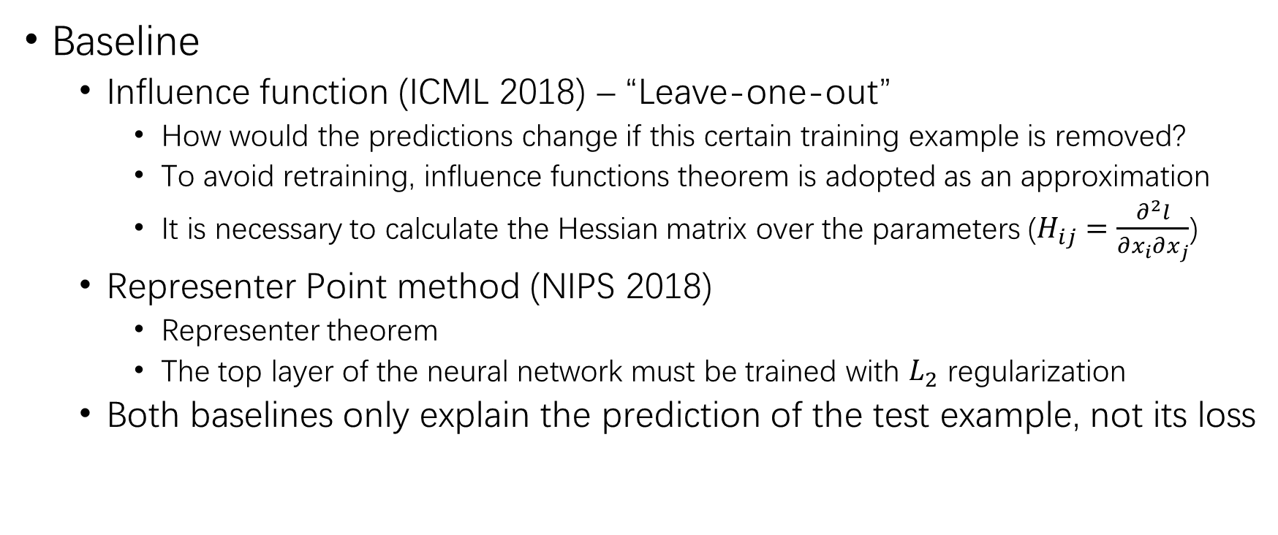
Evaluation (2)
Baseline
Influence function (ICML 2018) – “Leave-one-out”
How would the predictions change if this certain training example is removed?
To avoid retraining, influence functions theorem is adopted as an approximation
It is necessary to calculate the Hessian matrix over the parameters ($H_{ij}=\frac{∂^{2}l}{∂x_{i}∂x_{j}}$)
Representer Point method (NIPS 2018)
Representer theorem
The top layer of the neural network must be trained with $L_{2}$ regularization
Both baselines only explain the prediction of the test example, not its loss

Slide 17
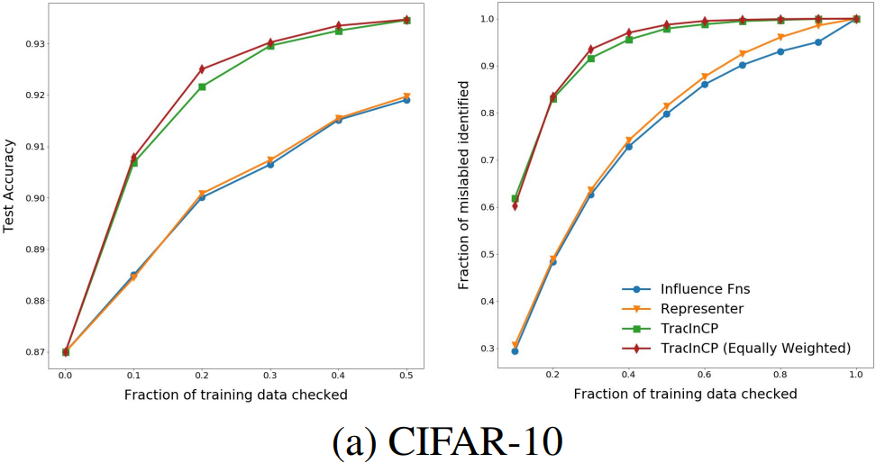
Evaluation – CIFAR-10
CIFAR-10 self-influence mislabeled example detection
ResNet-56 – Clean 93.4%, mislabeled 87.0%. 270 epochs, BS=1000, LR=0.1
Influence function – Hessian of the last layer only
Representer point – Last layer with line-search
TracInCP – Last layer only. Sample every 30 checkpoints

Slide 18
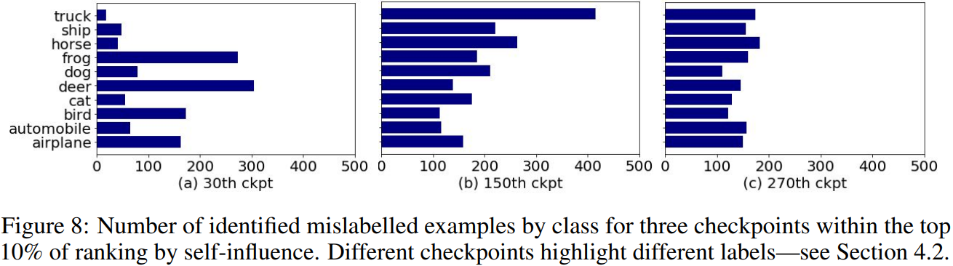
Evaluation – CIFAR-10 (2)
The model learns to identify different classes at different points in the training process

Slide 19
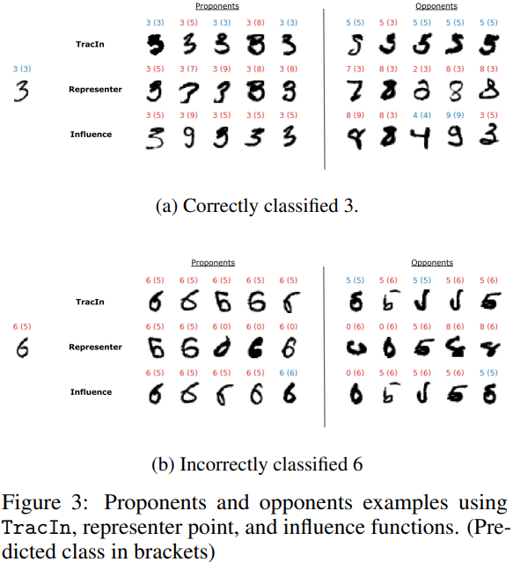
Evaluation – MNIST
MNIST proponents and opponents
3 hidden layers and 240K parameters
Model acc (clean) 97.55%

Slide 20
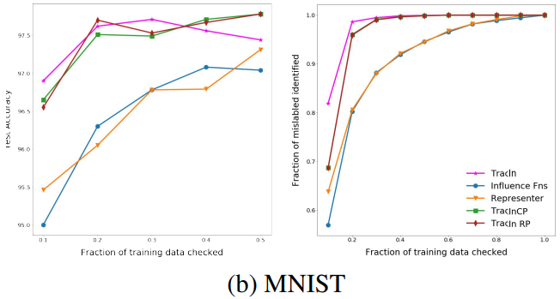
Evaluation – MNIST (2)
MNIST self-influence mislabeled example detection
Clean 97.55%, mislabeled 89.95%. 140 epochs
Ideal TracIn is also evaluated, as the model is small

Slide 21

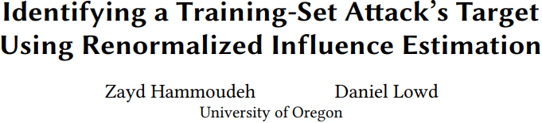

Slide 22
Goal
Target identification
Identify the target of a training-set attack
Provide insight into the attacker’s goals
Understand how to defend against them
Adversarial instance identification
Identify the malicious instances that constitute the training-set attack

Slide 23
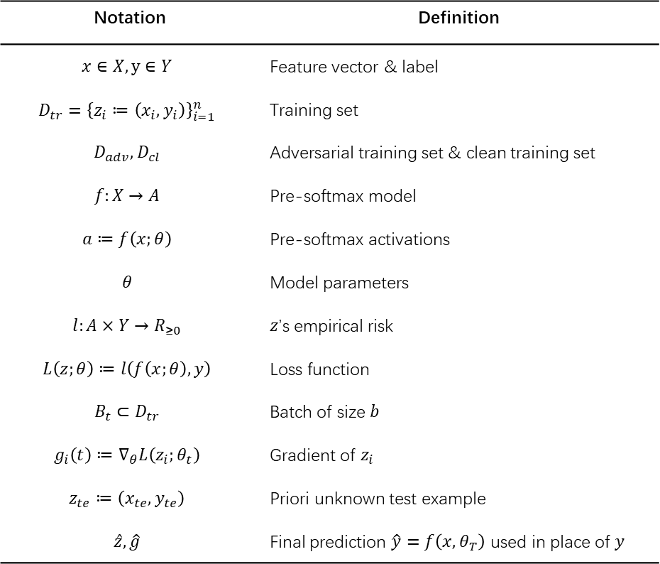
Notation
Notation | Definition
$$x∈X,y∈Y$$ | Feature vector & label
$$D_{tr}={\left\{z_{i}≔\left(x_{i},y_{i}\right)\right\}}_{i=1}^{n}$$ | Training set
$$D_{adv},D_{cl}$$ | Adversarial training set & clean training set
$$f:X→A$$ | Pre-softmax model
$$a≔f\left(x;θ\right)$$ | Pre-softmax activations
$$θ$$ | Model parameters
$$l:A×Y→R_{≥0}$$ | $z$’s empirical risk
$$L\left(z;θ\right)≔l\left(f\left(x;θ\right),y\right)$$ | Loss function
$$B_{t}⊂D_{tr}$$ | Batch of size $b$
$$g_{i}\left(t\right)≔∇_{θ}L\left(z_{i};θ_{t}\right)$$ | Gradient of $z_{i}$
$$z_{te}≔\left(x_{te},y_{te}\right)$$ | Priori unknown test example
$$\hat{z},\hat{g}$$ | Final prediction $\hat{y}=f\left(x,θ_{T}\right)$ used in place of $y$

Slide 24
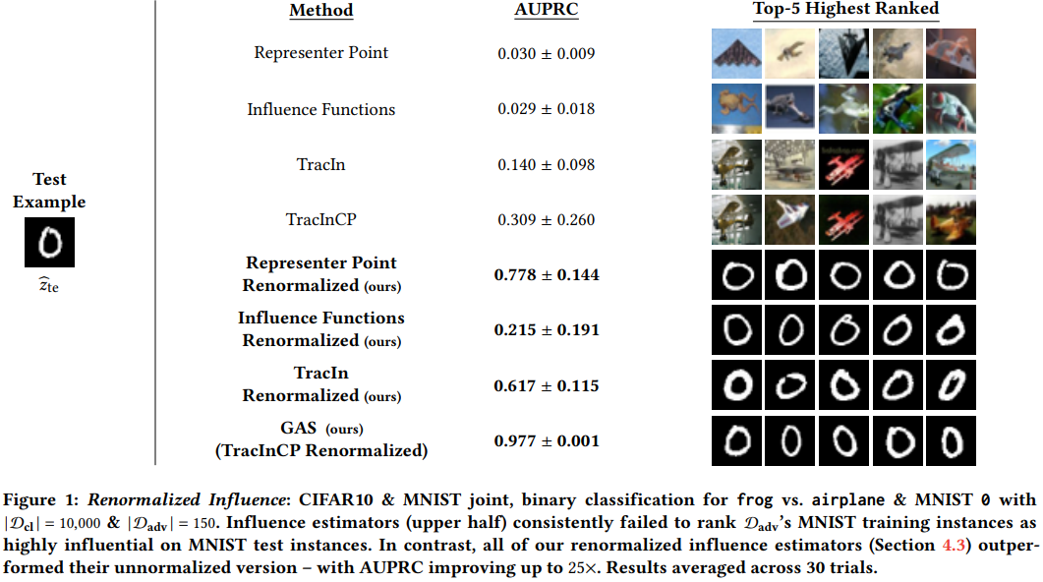
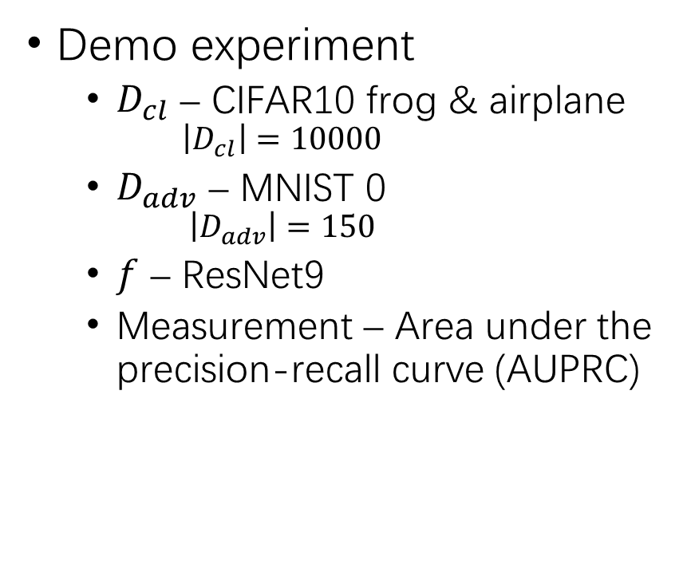
Challenge in Influence Estimation
Demo experiment
$D_{cl}$ – CIFAR10 frog & airplane
$$\left|D_{cl}\right|=10000$$
$D_{adv}$ – MNIST 0
$$\left|D_{adv}\right|=150$$
$f$ – ResNet9
Measurement – Area under the precision-recall curve (AUPRC)

Slide 25
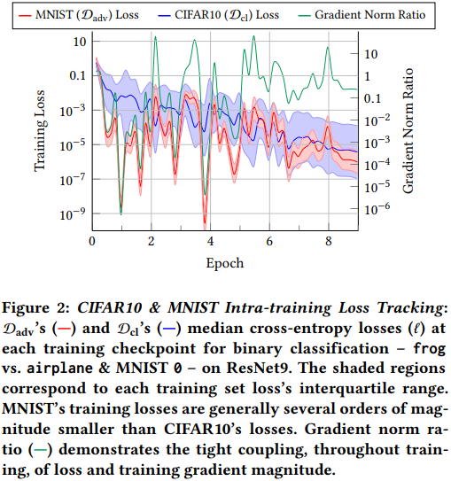
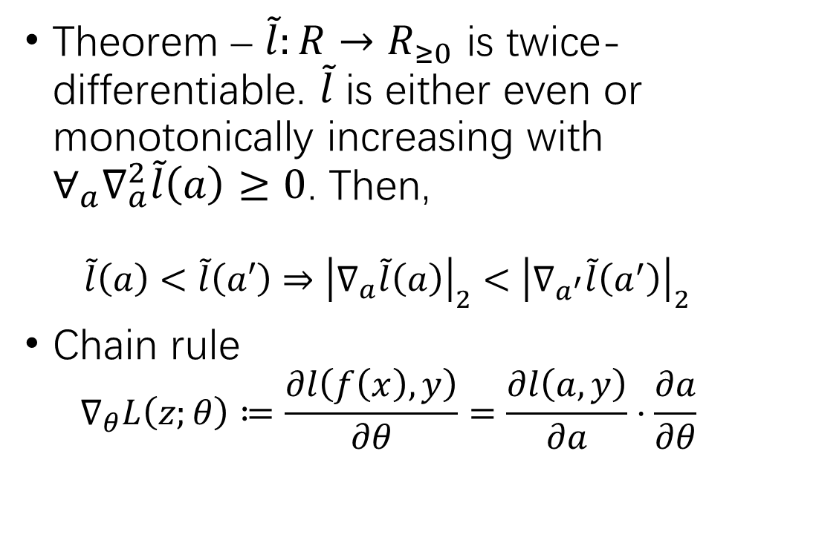
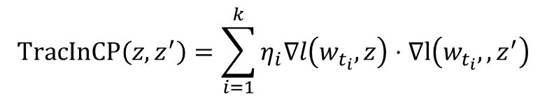
Low-Loss Penalty
$$TracInCP\left(z,z^{′}\right)=\sum_{i=1}^{k}{η_{i}∇l\left(w_{t_{i}},z\right)⋅∇l\left(w_{t_{i}},,z^{′}\right)}$$
Theorem – $\tilde{l}:R→R_{≥0}$ is twice-differentiable. $\tilde{l}$ is either even or monotonically increasing with ${∀_{a}∇}_{a}^{2}\tilde{l}\left(a\right)≥0$. Then,
$$\tilde{l}\left(a\right)<\tilde{l}\left(a′\right)⇒{\left|∇_{a}\tilde{l}\left(a\right)\right|}_{2}<{\left|∇_{a^{′}}\tilde{l}\left(a^{′}\right)\right|}_{2}$$
Chain rule
$$∇_{θ}L\left(z;θ\right)≔\frac{∂l\left(f\left(x\right),y\right)}{∂θ}=\frac{∂l\left(a,y\right)}{∂a}⋅\frac{∂a}{∂θ}$$

Slide 26
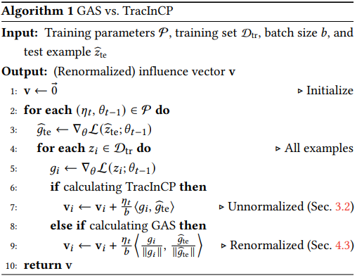
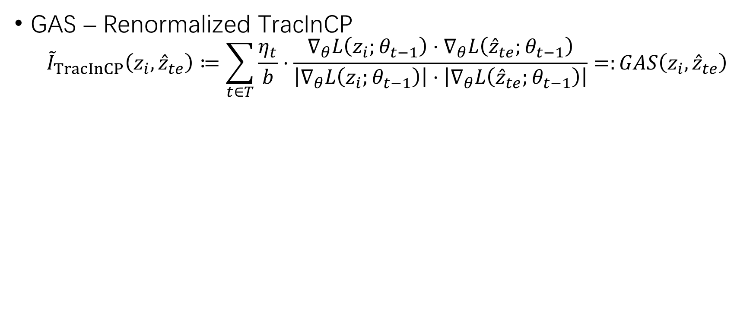
Gradient Aggregated Similarity
GAS – Renormalized TracInCP
$${\tilde{I}}_{TracInCP}\left(z_{i},{\hat{z}}_{te}\right)≔\sum_{t∈T}{\frac{η_{t}}{b}⋅\frac{∇_{θ}L\left(z_{i};θ_{t−1}\right)⋅∇_{θ}L\left({\hat{z}}_{te};θ_{t−1}\right)}{\left|∇_{θ}L\left(z_{i};θ_{t−1}\right)\right|⋅\left|∇_{θ}L\left({\hat{z}}_{te};θ_{t−1}\right)\right|}}=:GAS\left(z_{i},{\hat{z}}_{te}\right)$$

Slide 27
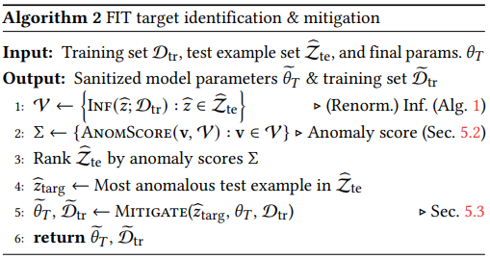
Framework for Identifying Targets
FIT
Measure influence
Identify anomalous influence (targets)
Mitigate target-driven attacks

Slide 28
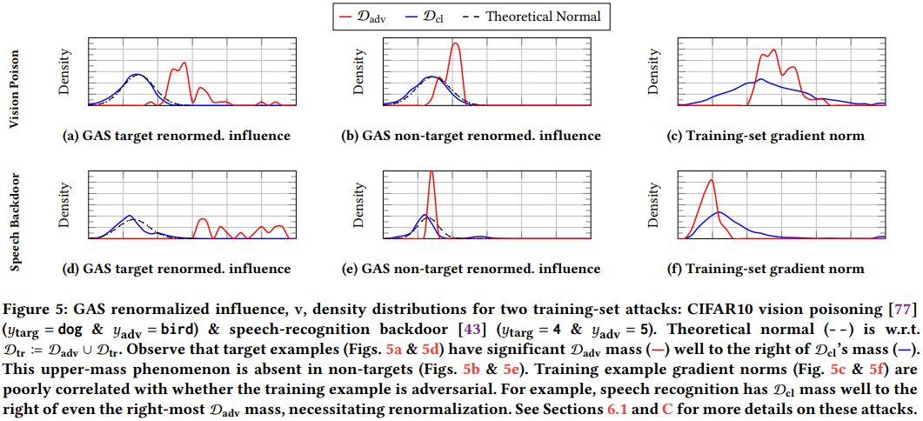
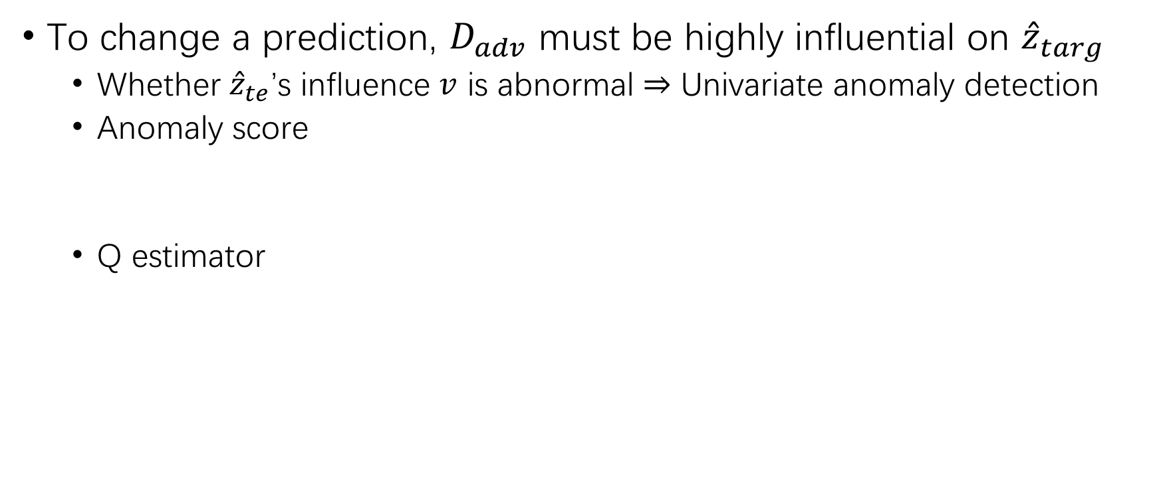
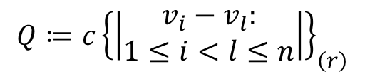
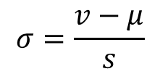
Identify Anomalous Influence
To change a prediction, $D_{adv}$ must be highly influential on ${\hat{z}}_{targ}$
Whether ${\hat{z}}_{te}$’s influence $v$ is abnormal $⇒$ Univariate anomaly detection
Anomaly score
Q estimator
$$σ=\frac{v−μ}{s}$$
$$Q≔c{\left\{\left|\begin{aligned}v_{i}−v_{l}: \\ 1≤i<l≤n\end{aligned}\right|\right\}}_{\left(r\right)}$$

Slide 29
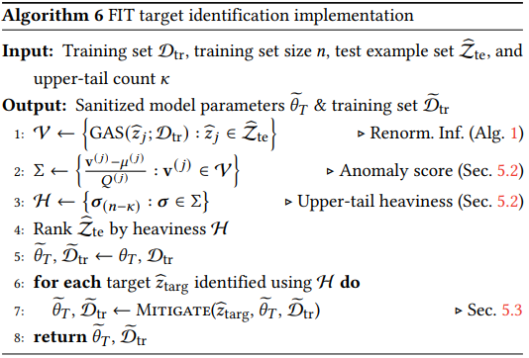
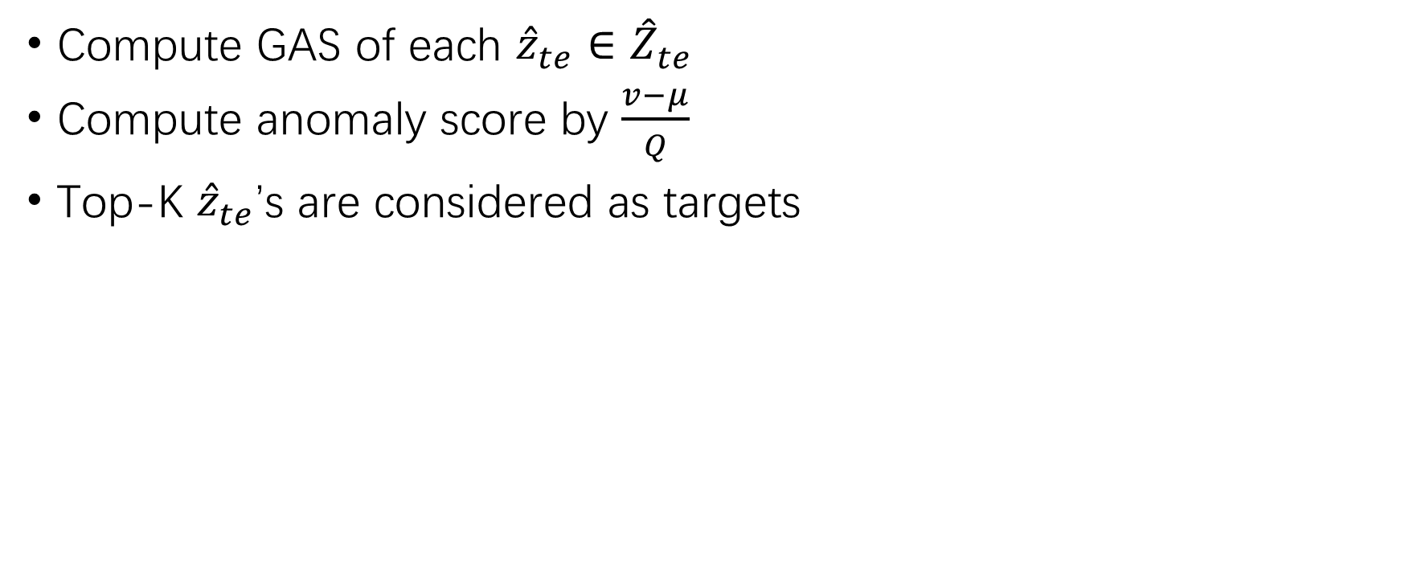
Identify Anomalous Influence (2)
Compute GAS of each ${\hat{z}}_{te}∈{\hat{Z}}_{te}$
Compute anomaly score by $\frac{v−μ}{Q}$
Top-K ${\hat{z}}_{te}$’s are considered as targets

Slide 30
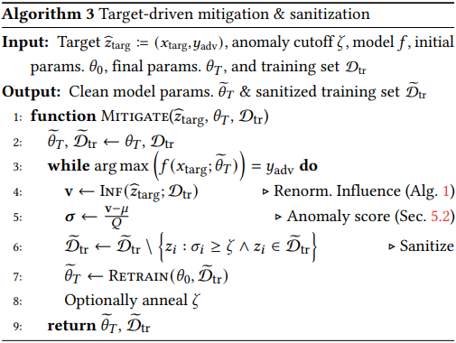
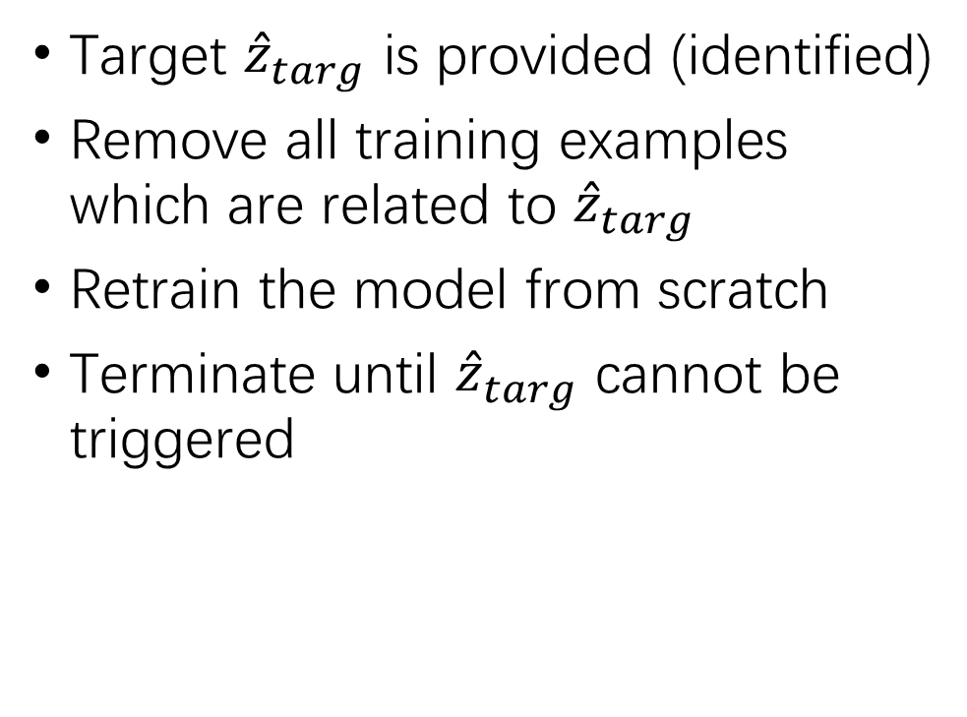
Target-Driven Attack Mitigation
Target ${\hat{z}}_{targ}$ is provided (identified)
Remove all training examples which are related to ${\hat{z}}_{targ}$
Retrain the model from scratch
Terminate until ${\hat{z}}_{targ}$ cannot be triggered

Slide 31
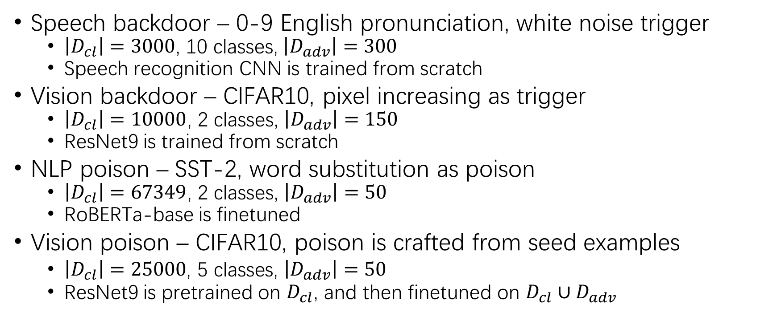
Evaluation
Speech backdoor – 0-9 English pronunciation, white noise trigger
$\left|D_{cl}\right|=3000$, 10 classes, $\left|D_{adv}\right|=300$
Speech recognition CNN is trained from scratch
Vision backdoor – CIFAR10, pixel increasing as trigger
$\left|D_{cl}\right|=10000$, 2 classes, $\left|D_{adv}\right|=150$
ResNet9 is trained from scratch
NLP poison – SST-2, word substitution as poison
$\left|D_{cl}\right|=67349$, 2 classes, $\left|D_{adv}\right|=50$
RoBERTa-base is finetuned
Vision poison – CIFAR10, poison is crafted from seed examples
$\left|D_{cl}\right|=25000\text{, }\text{5} \text{classes}\text{, }\left|D_{adv}\right|=50$
ResNet9 is pretrained on $D_{cl}$, and then finetuned on $D_{cl}∪D_{adv}$

Slide 32
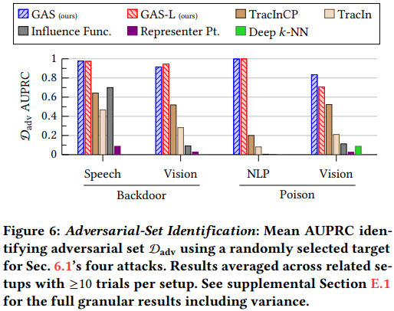
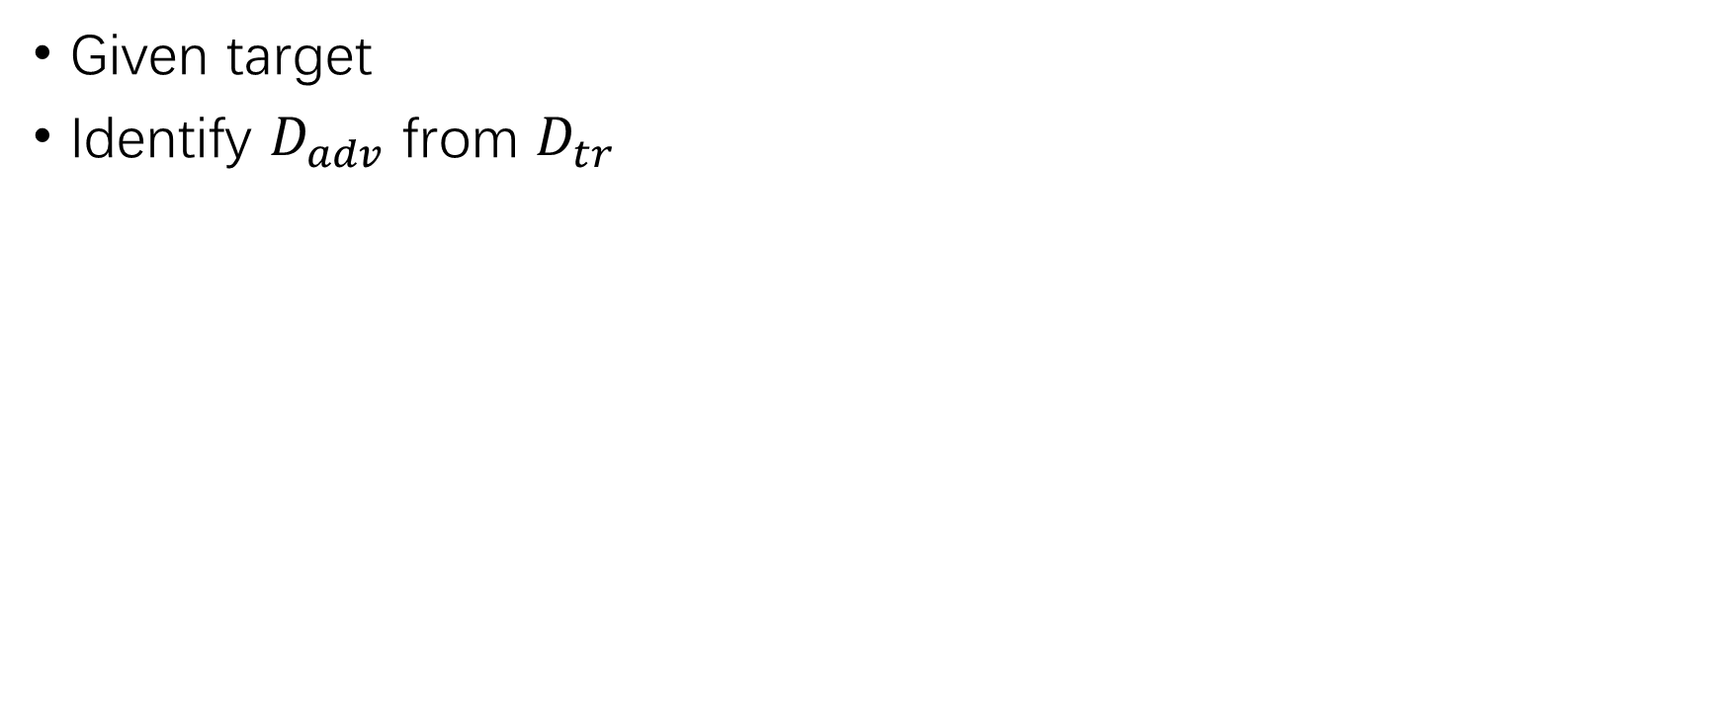
Evaluation – Adversarial Set Identification
Given target
Identify $D_{adv}$ from $D_{tr}$

Slide 33
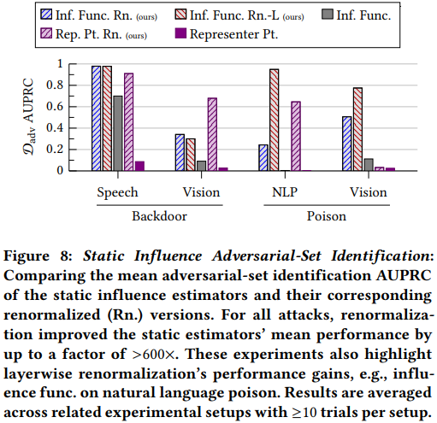
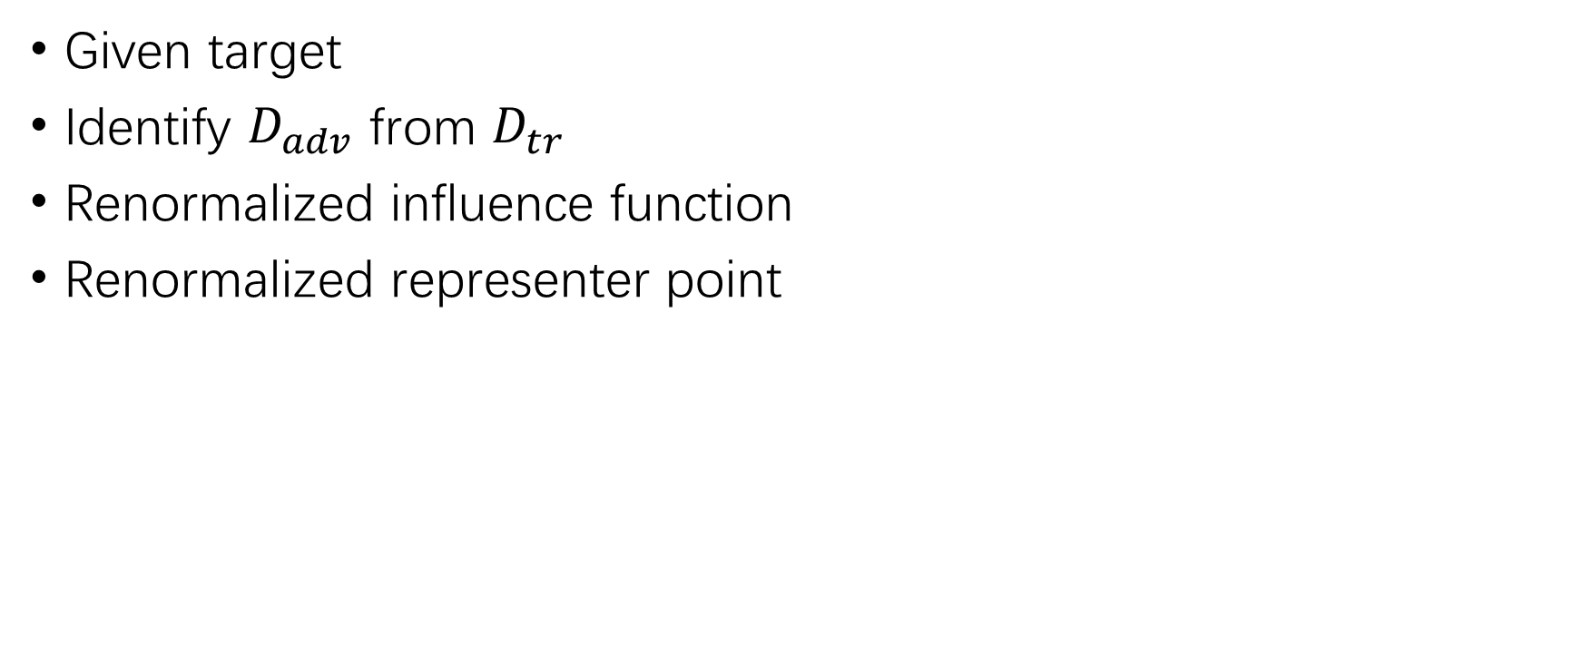
Evaluation – Adversarial Set Identification (2)
Given target
Identify $D_{adv}$ from $D_{tr}$
Renormalized influence function
Renormalized representer point

Slide 34
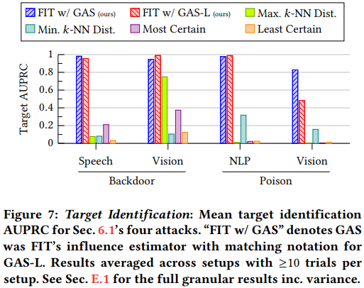
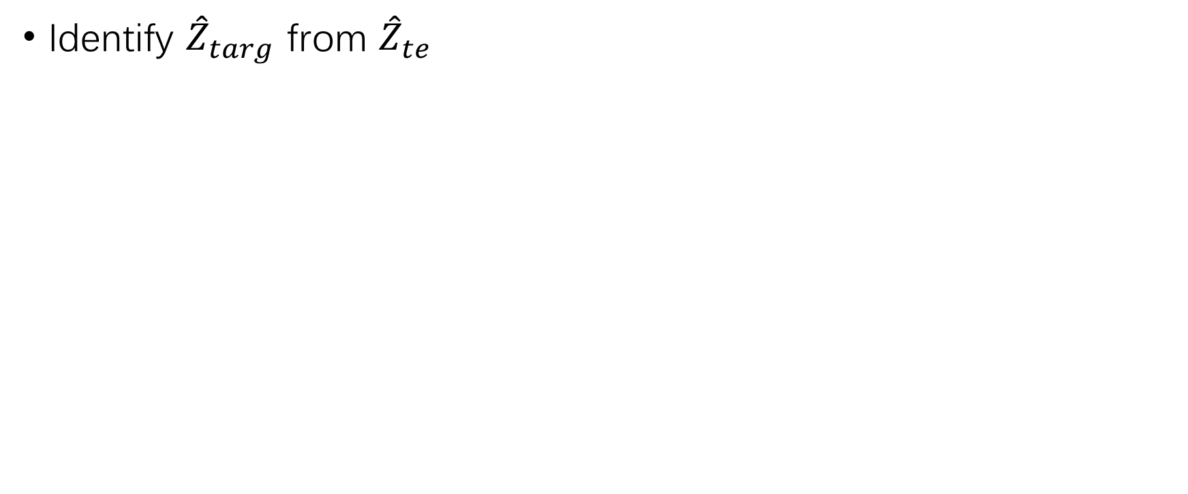
Evaluation – Target Identification
Identify ${\hat{Z}}_{targ}$ from ${\hat{Z}}_{te}$

Slide 35
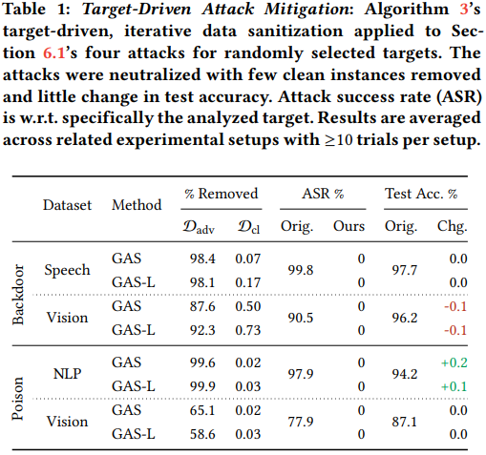
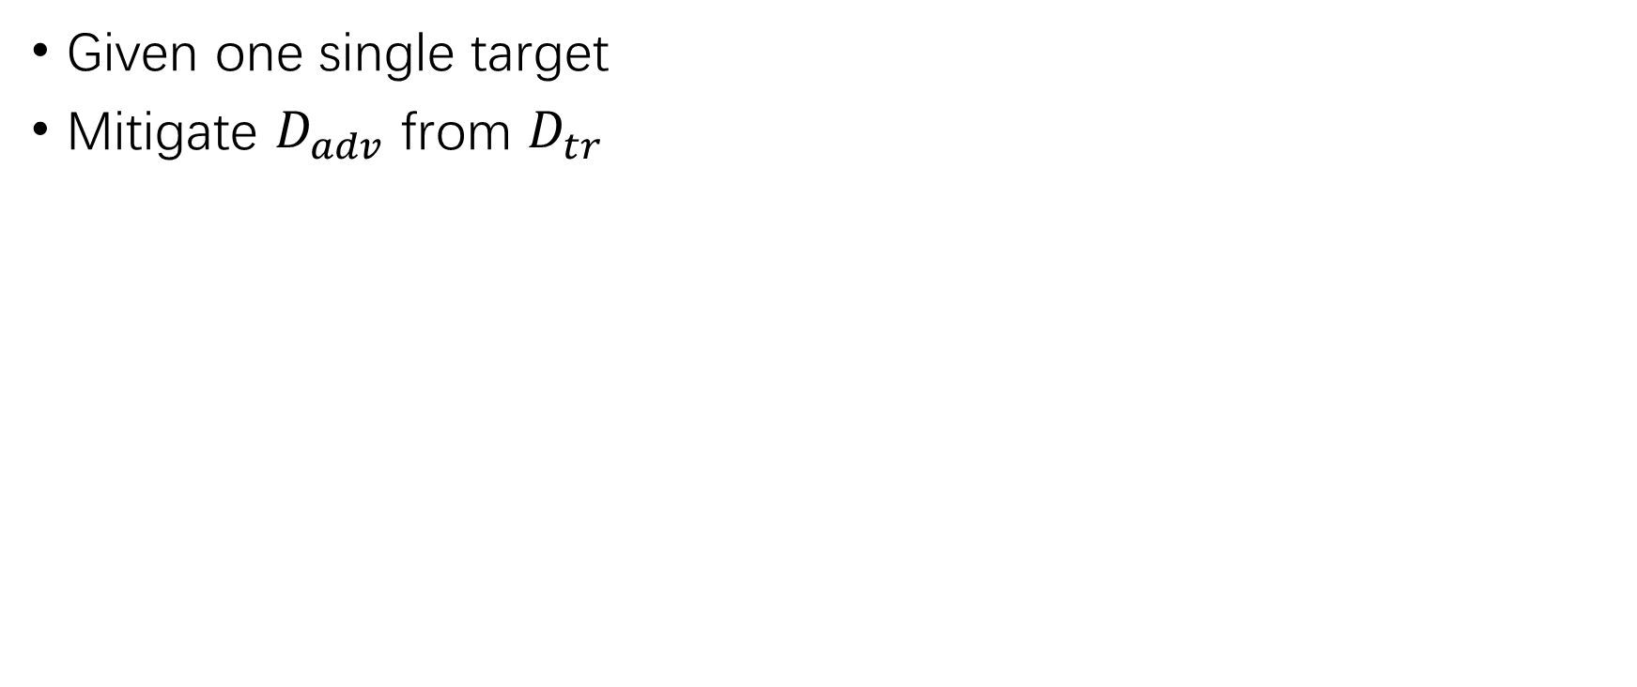
Evaluation – Attack Mitigation
Given one single target
Mitigate $D_{adv}$ from $D_{tr}$

Slide 36
THANK YOU!

